Slide 1
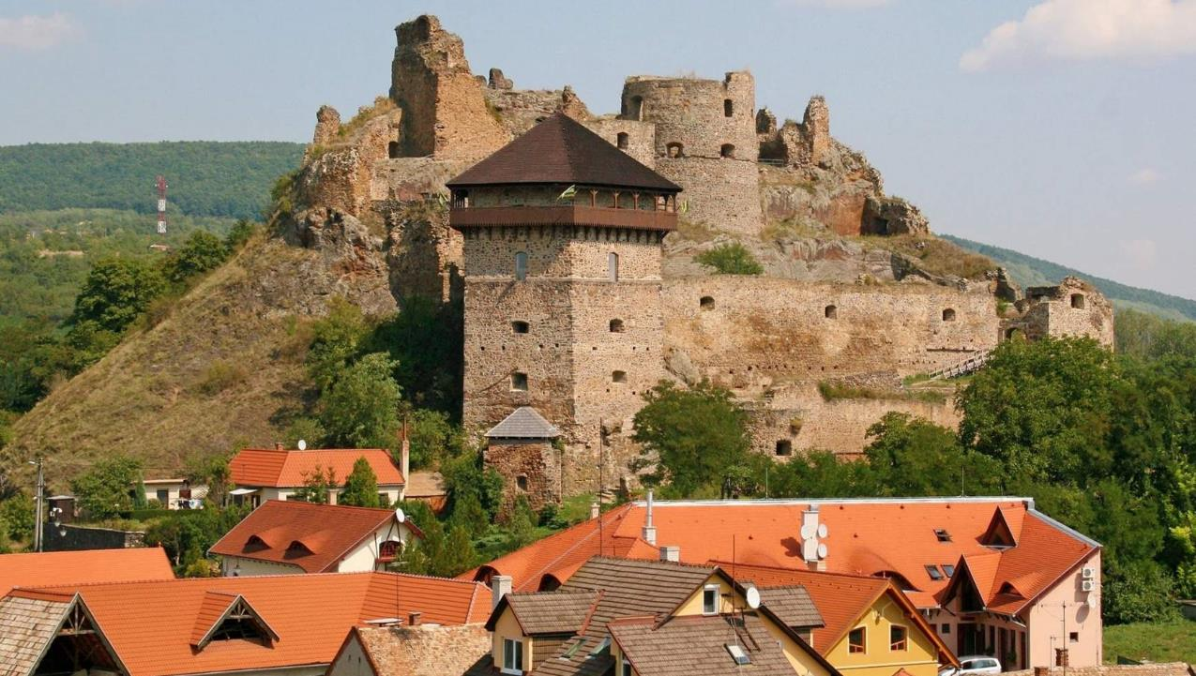
MOCSÁRY LAJOS ELEMENTARY SCHOOL
FIĽAKOVO
FÜLEK

Slide 2
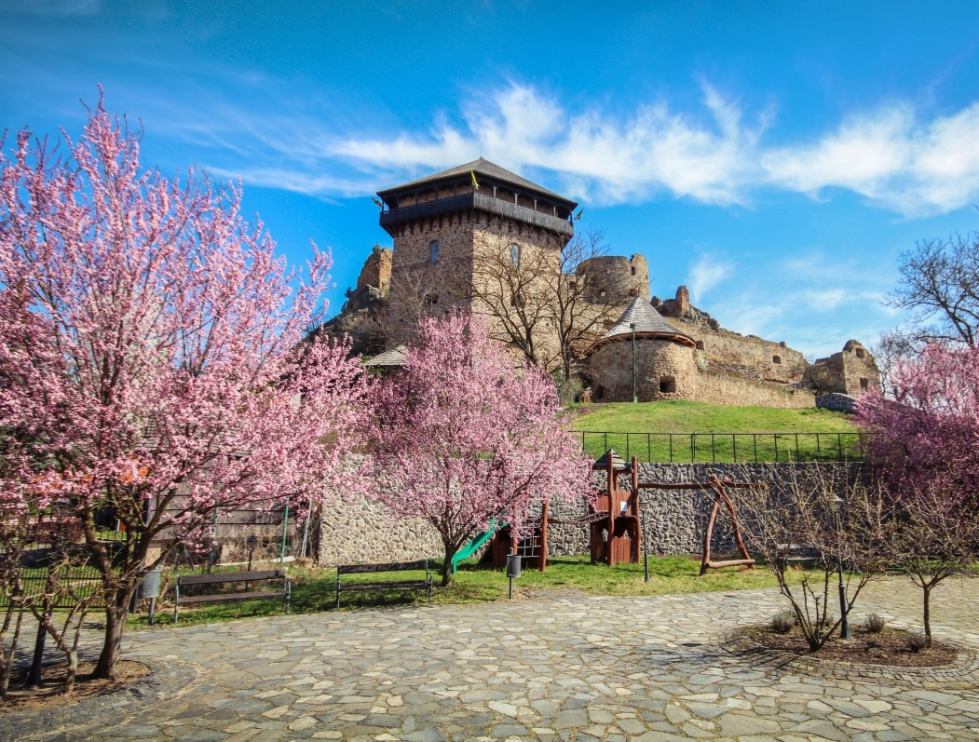
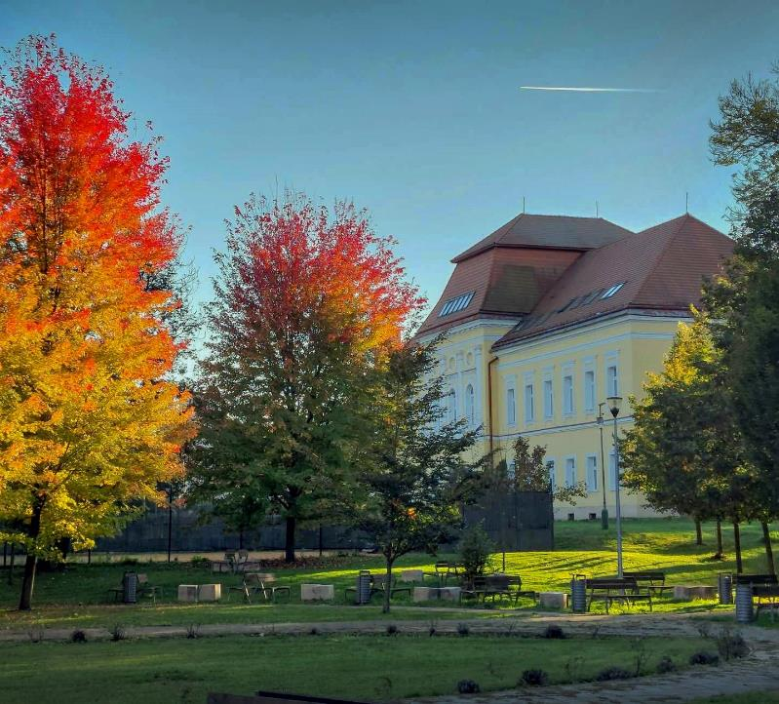
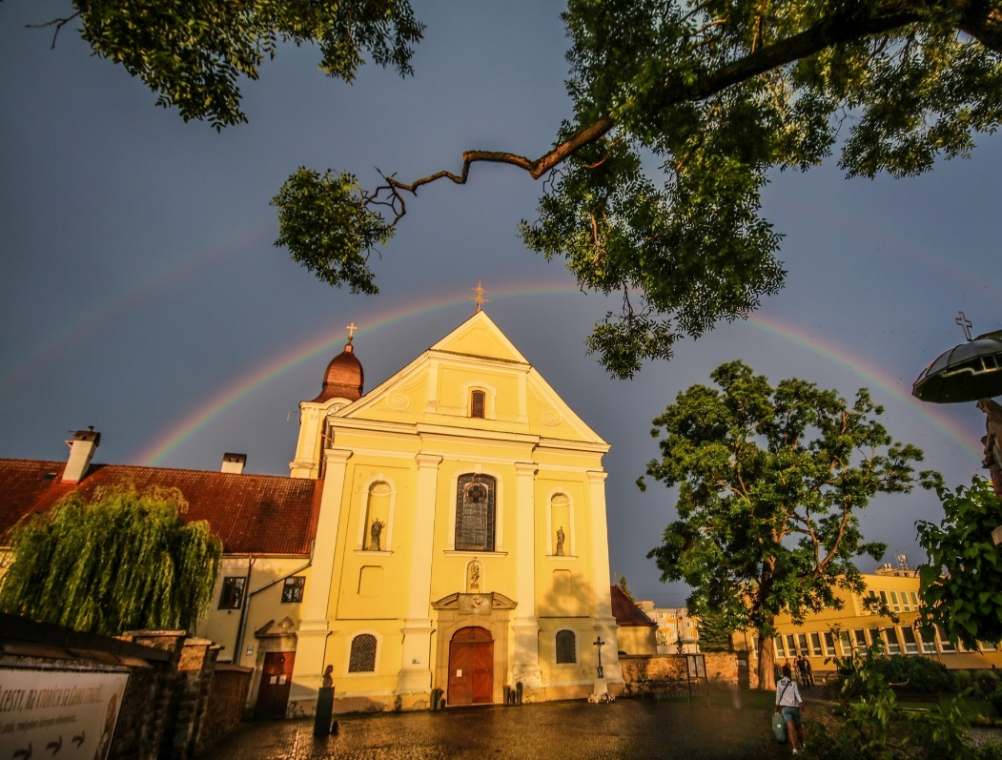
FIĽAKOVO IS A SMALL TOWN IN SOUTHERN SLOVAKIA.
IT IS INHABITED BY HUNGARIANS, SLOVAKS AND ROMANIES.

Slide 3
LAJOS MOCSÁRY
OUR SCHOOL WAS NAMED AFTER LAJOS MOCSÁRY
HE WAS A HUNGARIAN POLITICIAN, WHO SUPPORTED THE EQUALITY OF ALL NATIONALITIES

Slide 4
OUR SCHOOL
HUNGARIAN-SPEAKING ROMANI STUDENTS
CHALLENGES:
- POOR FACILITIES
- POVERTY

Slide 5
SOLUTIONS
EMPATHY
PRACTICAL LIFE SKILLS EDUCATION
COOPERATION WITH PARTNERS (Eurpean Investment Bank, Nurture International, Roma Education Fund, companies...)
MODERN METHODS

Slide 6
INNOVATIVE METHODS IN TEACHING GEOGRAPHY
TOPIC: THE WORLD‘S BIOMES
2 ELEMENTS:
- DISCOVER THE BIOMES (ANIMALS, PLANTS, WEATHER)
- PRACTICING THE KNOWLEDGE

Slide 7
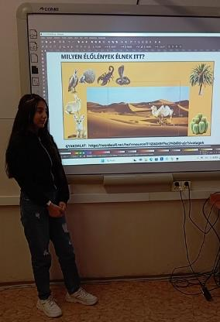
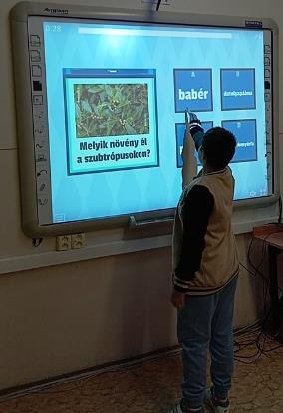
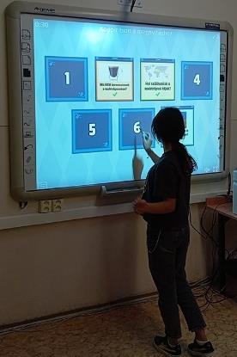
ADVANTAGES
MORE ACTIVE STUDENTS
BETTER MARKS
DISADVANTAGES
PROBLEMS WITH DISCIPLINE
OLD OR INADEQUATE EQUIPMENT

Slide 8
INNOVATIVE METHODS IN TEACHING HISTORY
MANY STUDENTS DO NOT STUDY AT HOME
FIXATION AND REPETITION PLAY AN IMPORTANT ROLE
GAME CALLED TRAVELERS

Slide 9
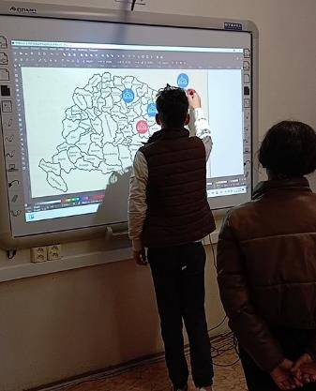
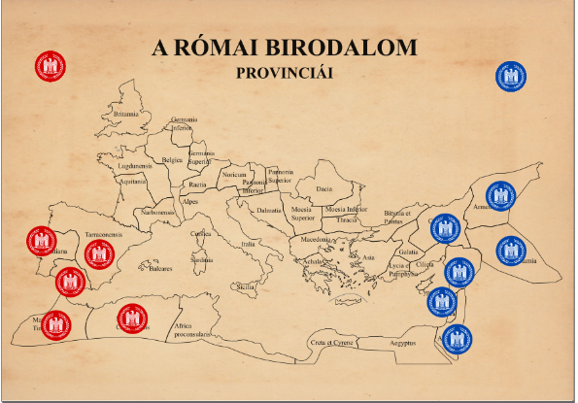
ADVANTAGES
THE STUDENTS ENJOY IT
FIXATION OF KNOWLEDGES
PLAY + LEARNING
DISADVANTAGES
COMPETITIVE ATTITUDE

Slide 10
INNOVATIVE METHODS IN TEACHING HUNAGRIAN LANGUAGE
POEMS IN IMAGES
WE USED THE ARTIFICAL INTELLIGENCE
VISUAL THINKING
QUICK

Slide 11
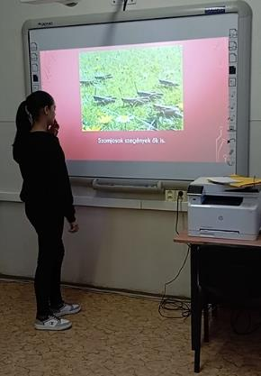
ADVANTAGES
INTERESTING
ENTERTAINING
INTERACTIVE
DISADVANTAGES
TIMES-CONSUMING
REQUIRES MANY TOOLS

Slide 12
INNOVATIVE METHODS IN TEACHING GERMAN LANGUAGE
FUNNY
INTERESTING
EDUCATIONAL

Slide 13
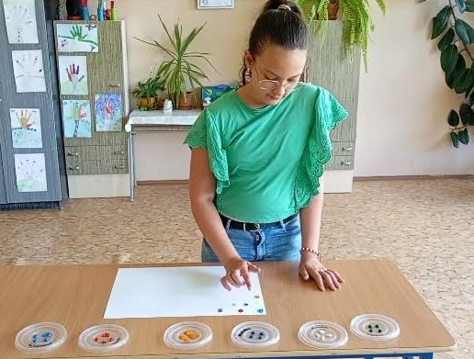
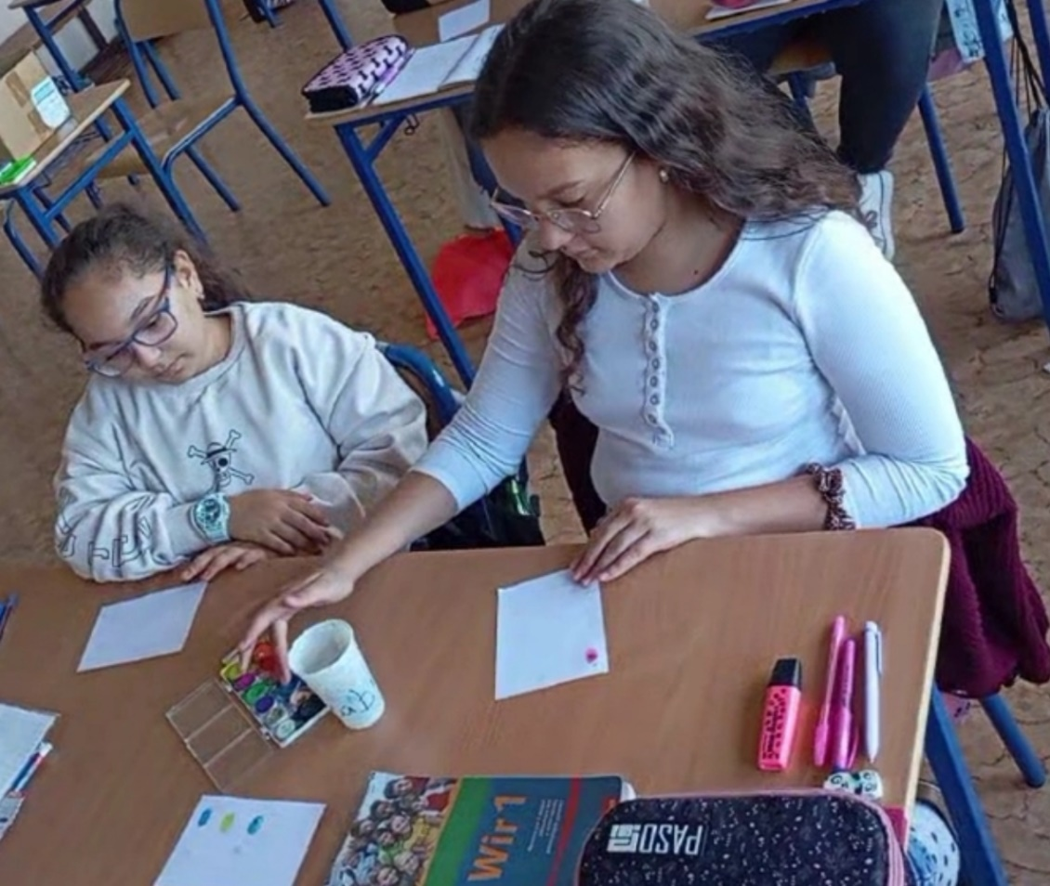
ADVANTAGES
PLAYFUL
FUN
EDUCATIONAL
SIMPLE
DISADVANTAGES
DISORDER
NOISE
EXHAUSTION

Slide 14
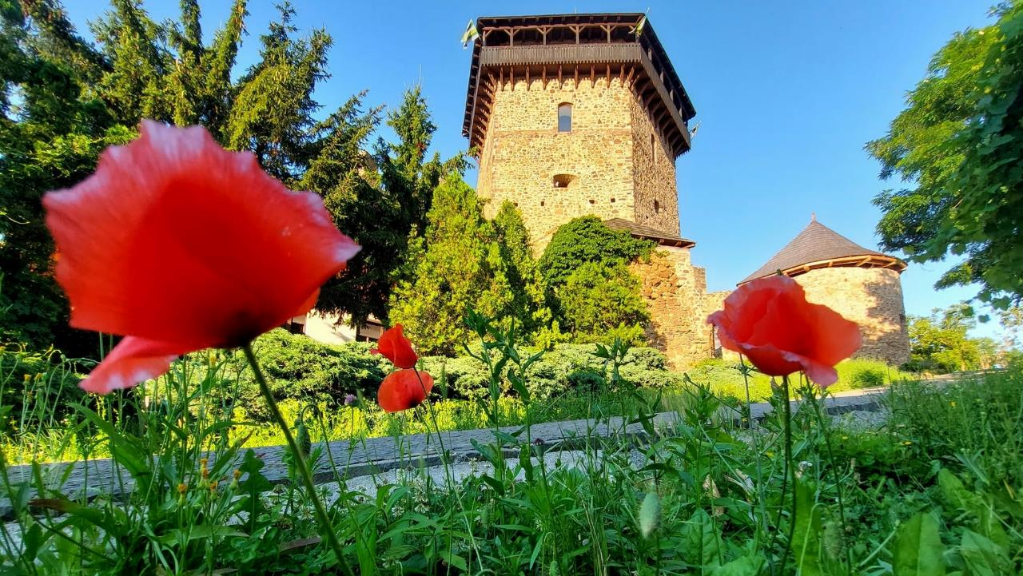
Thank you for your attention

